Slide 1
CS675 Big Data Management and Analytics
Final Project Presentation
Gita Gurung
Madeline Lin
Priyanka Chaudhari
Sukriya Gurung
Professor Syed Farid
December 3, 2022

Slide 2
Agenda
Introduction
Hadoop Framework
Data Science & Machine Learning
Blockchain
Text Analysis
Real-Time Analysis
Data Governance
Summary

Slide 3
Introduction
Data Analytics
The process of applying qualitative and quantitative techniques when examining data, with the goal of providing valuable insights
Big Data
Collections of datasets whose volume, velocity or variety is too large to store, manage, process and analyze using traditional databases and data processing tools
Hadoop

Slide 4
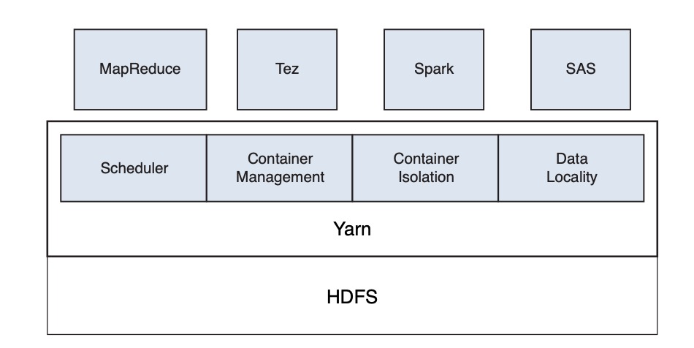
Hadoop Framework
Three Components
MapReduce
Yarn
HDFS

Slide 5
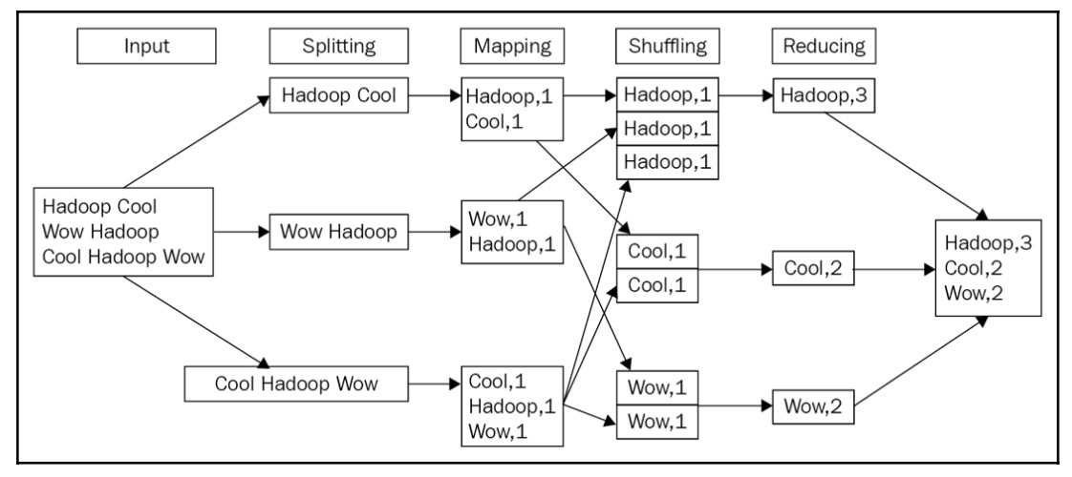
MapReduce
MapReduce is a java-based programming paradigm of Hadoop framework that provides scalability across various Hadoop clusters. It distributes the workload into various tasks that can run in parallel .
The Map Job
The Reduce Job

Slide 6
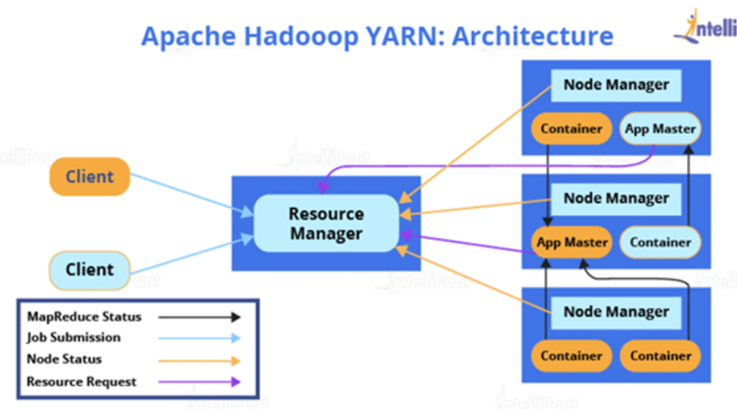
Yarn (Yet Another Resource Negotiator)
Yarn is a resource management computing platform that is designed completely different than traditional MapReduce.
Resource Manager
Application Master
Node Manager

Slide 7
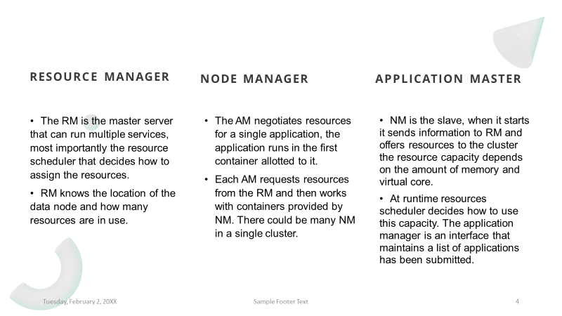
Yarn Components
Yarn (Yet Another Resource Negotiator)

Slide 8
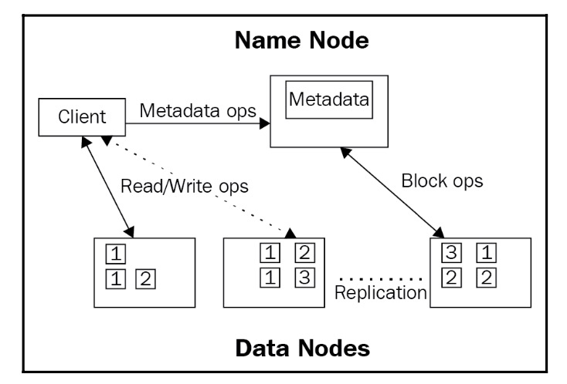
HDFS (Hadoop Distributed File System)
HDFS is a java-based file system for scalable and reliable storage of large datasets. The main concept behind HDFS is that it divides a file into blocks instead of dealing with a file as a whole.
NameNode
DataNode

Slide 9
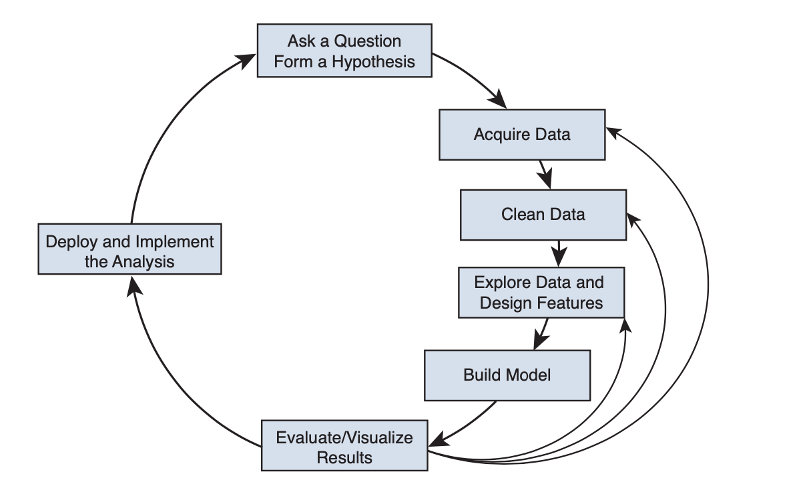
Data Science
Data Science is the exploration of data via the scientific method to discover meaning or insight and the construction of software systems that utilize such meaning and insight in a business context.
Key data processing engines
HDFS
Yarn
Hive
Pig
Spark
Sqoop
Fume
Popular modeling tools
R
Python

Slide 10
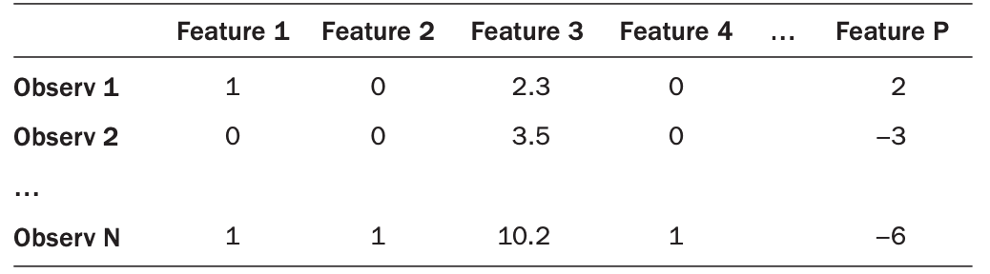
Machine Learning
Machine learning is a combination of statistics, computer science, and applied mathematics. Deep learning is based on neural networks. Deep learning algorithms consist of multiple layers of neural networks.
Terminology
Observation
Feature
Target

Slide 11
Applications
Blockchain
Blockchain is a decentralized ledger, or list, of all transactions across a peer-to-peer network. Blockchain in Hadoop can impose security while making transactions, enables the possible intercluster communication, race between miners for validating and authorizing transactions, integrating the global economy with electronic currency for any kind of trading goods, materials, money, etc.
BlockHDFS

Slide 12
Applications
Text Analysis
Text analysis is a machine learning technique used to automatically extract valuable insights from unstructured text data. Companies use text analysis tools to quickly digest online data and documents, and transform them into actionable insights. Text analysis delivers qualitative results while text analytics delivers quantitative results.
Text analysis tools allow businesses to structure vast quantities of information, like emails, chats, social media, support tickets, documents, and so on, in seconds rather than days, so we can redirect extra resources to more important business tasks.

Slide 13
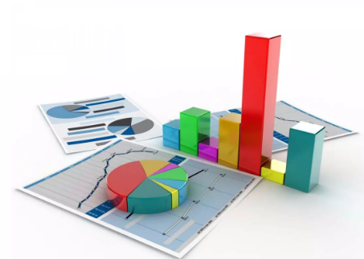

Applications
Real-Time Analysis
Big data analysis “Big Data Analysis is the process of examining large data sets to uncover hidden patterns, unknown correlations, market trends, customer preferences and other useful business information.
The platforms that can handle real time streaming big data are Apache Storm, Apache Kafka, IBM Infosphere Streams, etc.
Predictive Analysis
Text Analysis
Data Mining
Statistical Analysis

Slide 14
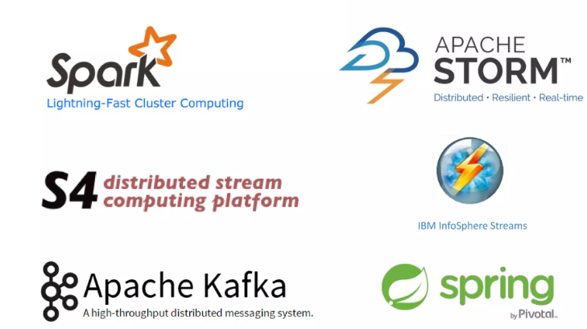
Applications
Real-Time Analysis (cont.)
Real Time Analysis of Big Data Tools

Slide 15
Data Governance
Data governance refers to the rules, structures, processes, and practices that allocate the roles, responsibilities, and rights of participants in big data analytics. This governance policy is intended to meet all relevant compliance with applicable laws and objectives of operating the big data platform in a safe and sound manner.
The framework consists of eight capabilities including organization, metadata management standards, data classification, security, privacy, and compliance standards, data usage agreement (“DUA”), security operations and policies, information lifecycle management, and data quality standards.

Slide 16
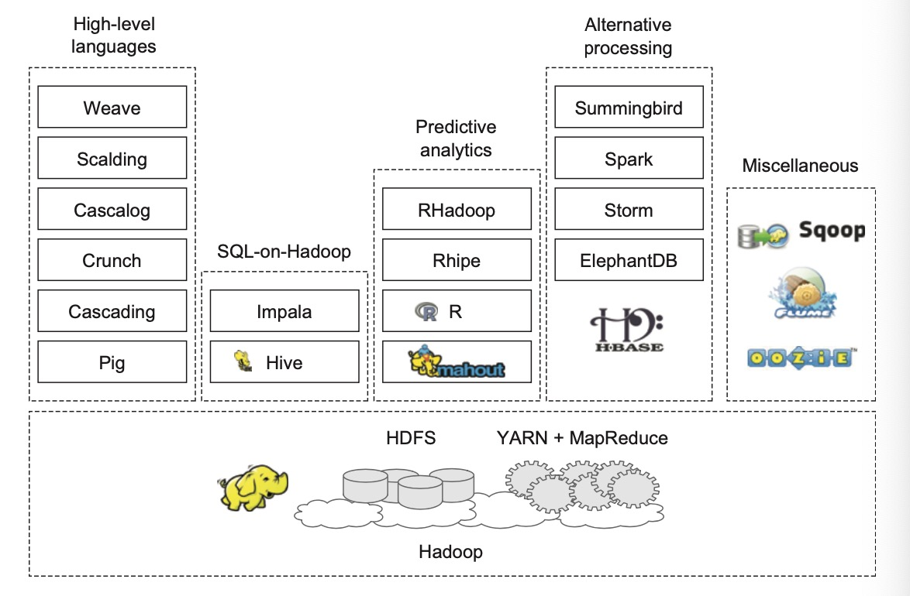
Finally…

Slide 17
Reference
Lecture Note: Overview of big data analytics
Lecture Note: Introduction to Big Data
Lecture Note: Hadoop in Heart Beat
Lecture Note: Practical Data Science with Hadoop and Spark
Lecture Note: Hadoop data modeling
Lecture Note: Hadoop machine learning
Lecture Note: Introduction to Yarn
Lecture Note: Big Data Governance
Lecture Note: Blockchain-integrated Hadoop Distributed File System For Secure Provenance Traceability
Lecture Note: Big-Crypto Big Data, Blockchain and Cryptocurrency
Lecture Note: LoT Big Data provenance scheme using blockchain on Hadoop ecosystem
Lecture Note: Twitter sentiment analysis using Hadoop
Lecture Note: DataServices text analysis and Hadoop
Lecture Note: Data munging with Hadoop
Lecture Note: Sentiment analysis of tweets using Hadoop
Lecture Note: Real time analysis
Lecture Note: Data acquisition
Yao, Y., Wang, J., Sheng, B., Lin, J., & Mi, N. (2014). Haste: Hadoop Yarn Scheduling based on
task-dependency and resource-demand. 2014 IEEE 7th International Conference on Cloud Computing. https://doi.org/10.1109/cloud.2014.34

Slide 18
Questions
Thank you

